Slide 1
CT Project Weekly Status Report
Jack Xu, Jenny Jiang Aug 7, 2020

Slide 2
Our work this week
Transferred all codes to company’s account
Both client side and server side
Made app work on two pair of testing devices
Made a breakthrough and get contact shield SDK work

Slide 3
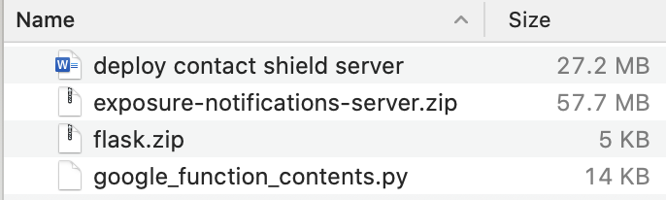
Transferred code to company’s account
Client-side code has been synchronized to Futurewei’s GitLab
Quality ensured by SonarQube
Server-side code has been moved to company’s google cloud account
Made documents about how to set up the server from scratch.
Four components: Google SQL, Google Storage, Google Instance, Google Functions
Three parts of code: Google Function, Flask, Google instance

Slide 4
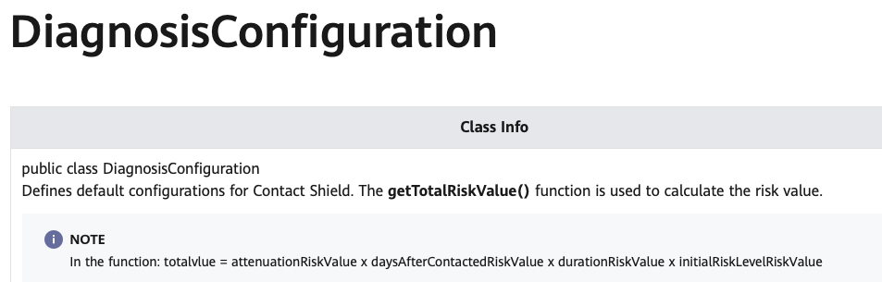
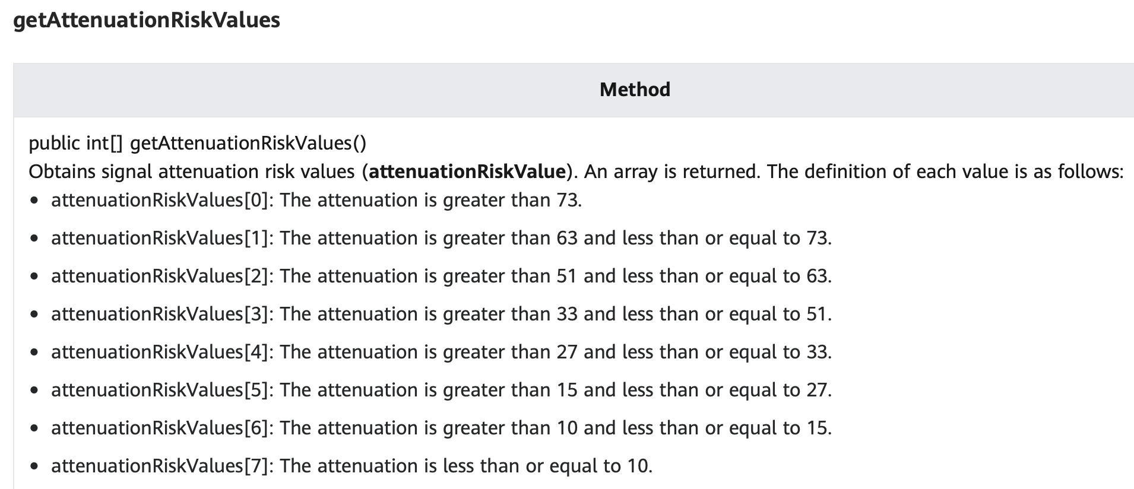
Breakthrough for this week
Issue: Values of certain fields returned by Contact shield are always fixed, even using Huawei sample code
Findings: We checked the source code of contact shield to see why it does not work. We found we made the false assumption of one class.
1-4096
1-8
1-8
1-8
1-8

Slide 5
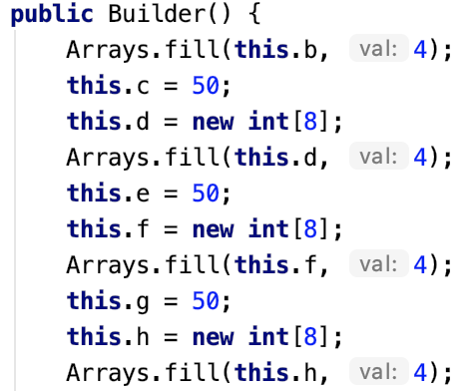
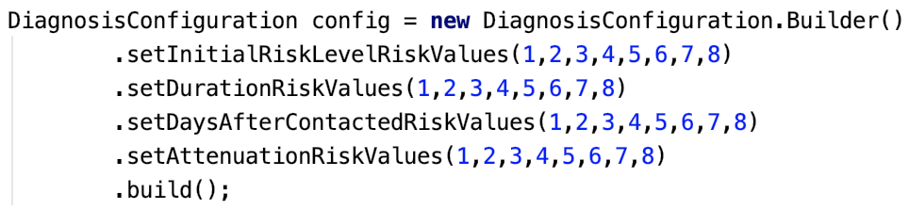
Breakthrough for this week
What we assumed
What it actually is
Their source code
What need to be done
0 → 1
1 → 2
2 → 3
3 → 4
4 → 5
5 → 6
6 → 7
7 → 8
0 → 4
1 → 4
2 → 4
3 → 4
4 → 4
5 → 4
6 → 4
7 → 4

Slide 6
Plans for next week
Test more and try to make the app stable enough for deployment

